Slide 1
Orchard CMS
Tieng Si PHAN – 02/06/2015

Slide 2
What is Orchard CMS
Orchard CMS is a free , open source, community-focused content management System built on the ASP.NET MVC platform.
Orchard CMS can be used for creating public facing websites, blogs, forums or web apps
ShowOrchard is an awesome website which shows one of the best websites created using Orchard CMS www.showorchard.com

Slide 3
Technologies used by Orchard CMS
ASP.NET MVC – Web Framework
WebApi – Web Service in Orchard
AutoFac – Dependency Injection
Castle – Dynamic Proxy
Nhibernate – ORM (Database)
Many more…

Slide 4
Source code or Web project
There are two different scenarios in which Orchard CMS can be used 1.User and 2.Developer
User : Web project is a web-ready instance of Orchard CMS which is ready for deployment
Developer : Source code project contains the whole source code of Orchard CMS which is to be used by a developer for creating custom modules or may be extend some features within Orchard.

Slide 5
Recipes in Orchard CMS
Recipes in Orchard allows us to select the environment for our Orchard CMS Installation
Orchard CMS provides 3 Recipes by default:
Default : Provides out of the box features of Orchard i.e. Pages, Blogs, Modules, Navigation, Themes …
Blog : Provides only the Blog feature
Core : Intended for developers who will create custom modules and themes

Slide 6
How to install Orchard CMS using IIS
Copy-Paste the Orchard folder within the wwwroot folder.
Open IIS Manager, Convert to application and apply App-Pool.
Give write permissions to the App_Data, Modules, Themes and the Media folder.
Browse to the website.
Orchard CMS Installation Page, Select Recipe and click Finish Setup.

Slide 7
Orchard CMS Folder Structure
App_Data : For storing Dependencies , Logs, Recipes , Sites
Bin : For storing .dll files required by Orchard
Config : Contains configuration files
Core : Contains the core features provided by Orchard
Media : This folder is used to store contents like Images or any other files within a folder named similar to the selected Recipe while installing Orchard
Modules : Modules are stored in the Modules folder
Themes : Themes are stored in the Themes folder

Slide 8
Themes
Installing themes from the Orchard Theme Gallery
Bindtuning.com
Demo: Themes in Orchard (bootstrap theme)

Slide 9
Themes

Slide 10
Modules
Modules according to categories
How to install Modules from the Orchard Module Gallery
Demo: Modules in Orchard

Slide 11
Modules

Slide 12
Pages and Blogs
How to Create a page and publish a page
How to Create a blog and post a blog post
Demo:
Create a page (about us)
Create a blog, post a blog post (my blog post)

Slide 13
Pages and Blogs

Slide 14
Content Types
Content type can be seen as a category of content
Content type consists of content parts and content fields
Page or Blog is a content type in orchard
Content types are built from smaller parts called content parts
Demo: How to create a content type in Orchard (School Students)

Slide 15
Content Types

Slide 16
Content Parts
Content Parts are pieces of reusable unit in Orchard for ex. TitlePart, CommonPart, AutoroutePart, BodyPart, CommentPart, TagPart, MenuPart… that can be appended to any content type.
Demo: Adding content parts to a content type (School Students)

Slide 17
Content Parts

Slide 18
Content Fields
Are pieces of information that can be added to a content type
They have a name and a type are specific to a content type
Demo: Show different types of Content fields that can be added to a content type (School Students)

Slide 19
Content Fields

Slide 20
Content Items
Is a single piece of content often associated with a single url address
Pages , blog posts are content items
Demo: Creating a content item for our content type (joe1, joe2… for School Students)

Slide 21
Content Items

Slide 22
Layers
A layer is group of widgets with their positioning , zone name and ordering that is activated by a specific rule
Link to explained about layer rule
Demo: How to create a layer with a rule for a specific range
Widgets => Add a New layer (About Us) and filter follow About Us page
Add a Html Widget to Content zone

Slide 23
Layers
Rule Syntax | Description
url("<url path>") | True if the current URL matches the specified path. If you add an asterisk (*) to the end of the path, all pages found in subfolders under that path will evaluate to true (for example, url("~/home*")).
authenticated | True if the user is logged in.
ContentType("<Type>") | True if the content type being view matches the content type specified e.g. ContentType("Page")
not | Logical NOT.
and | Logical AND.
or | Logical OR.
Ex: About page if the user is not authenticated, or on any page if the user is authenticated. (not authenticated and url("~/about")) or authenticated To allow multiple URL values, you can use the following syntax: url("~/foo") or url("~/bar")

Slide 24
Layers

Slide 25
Widgets and Zones
Widget is a small fragment of UI that can added to some or all pages of the site
ex. Tag clouds, blog post archives…
Zones are specific parts of a Layout that can be customized by inserting a widget
Demo:
Creating a HTML widget and then placing it in a specific zone
Adding a Recent Blog Posts widget to Content zone.

Slide 26
Widgets and Zones

Slide 27
Widgets and Zones

Slide 28
Queries
Queries is a feature in orchard which allows us to create queries from the admin panel based on the following three parameters
Filter : for ex. Content types
Sort Criteria : for ex. Creation date, Publication date
Layout : Renders Grid, HTML List, etc.
Demo: How to create a query for the newly created content type (Student Query)

Slide 29
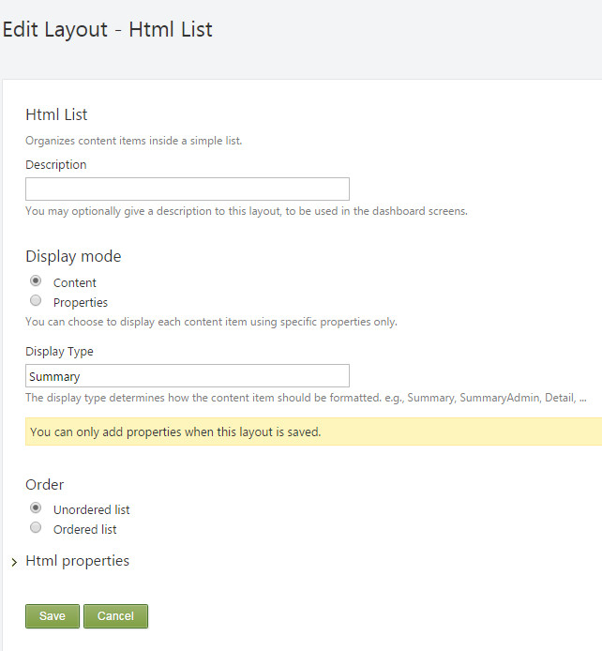
Queries

Slide 30
Projection
Projection feature and the Queries feature go hand in hand
Queries feature is used to create a query based on a specific content type. But, a query doesn't do anything by itself
That's where projection feature comes into place
Projection is used to project the result of the query created by the Queries Module
Demo: How to project the results of the query using Projection module
Create a “All Students” Page
Create a “Students” Projection using Student Query
Using Widget module to add a new Layer with layer rule url ‘~/ all-students’
Add a Projection Widget to Content zone

Slide 31
Projection

Slide 32
Projection

Slide 33
Taxonomies
Taxonomies module provides categorization of content types in Orchard
Demo: How to create a Taxonomy and create a Term
Create a new taxonomy (categories)
Create some terms
Orchard cms
Asp.net mvc
Model binding
…

Slide 34
Taxonomies

Slide 35
Taxonomies

Slide 36
Navigation
Navigation menus can be created in a lot of different ways in Orchard
Content Menu Item : Add a content item to the menu
Custom Link : Represents a simple custom link with a text and a url
HTML Menu Item : Render some custom HTML in the menu
Query Link : Inject menu items from a query
Taxonomy Link : Inject menus from a taxonomy

Slide 37
Navigation

Slide 38
Media Library and Image Editor
Demo Media Library
Install Image Editor Module
Use Image Editor in Media Library

Slide 39
Media Library and Image Editor

Slide 40
More Information
http://docs.orchardproject.net/
https://www.udemy.com/orchard-cms-for-absolute-beginners
http://orchardbeginner.com/

Slide 41
Thank you!

